Slide 1
Risk Management in Construction
John Holland Group Pty Ltd
Mathew Jonston

Slide 2
John Holland Group
A subsidiary of CCCI.
One of Australia’s leading engineering, contracting and services providers to the infrastructure, energy and resources and transport sectors.
Revenue approx. $6B/yr. Typically we deliver, complex and challenging projects.
Westgate Bridge Strengthening
Level Crossing Removals
20% share of MTM
Melbourne Metro Early Works
Westgate Tunnel and Melbourne Metro PPP
The Corporate Risk Management function provides oversight of all business risks. 5 distinct functions:
Pre-Contracts
Enterprise Risk Management
Business Continuity and Crisis Management
Independent Project Reviews
Insurance

Slide 3
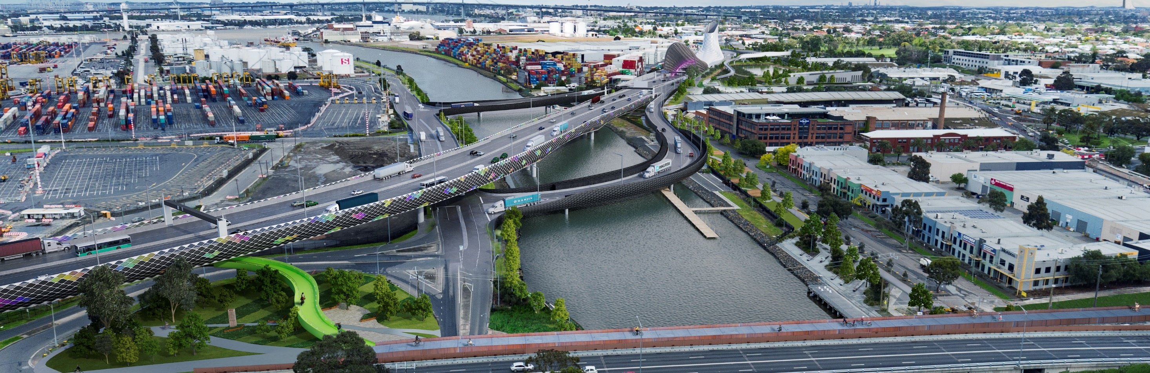
Agenda
Focus on application of risk management to the pre-contracts part of our business, i.e. tendering
Some data
The problem
One business line - Tunnelling
The approach
Wrap and Questions

Slide 4
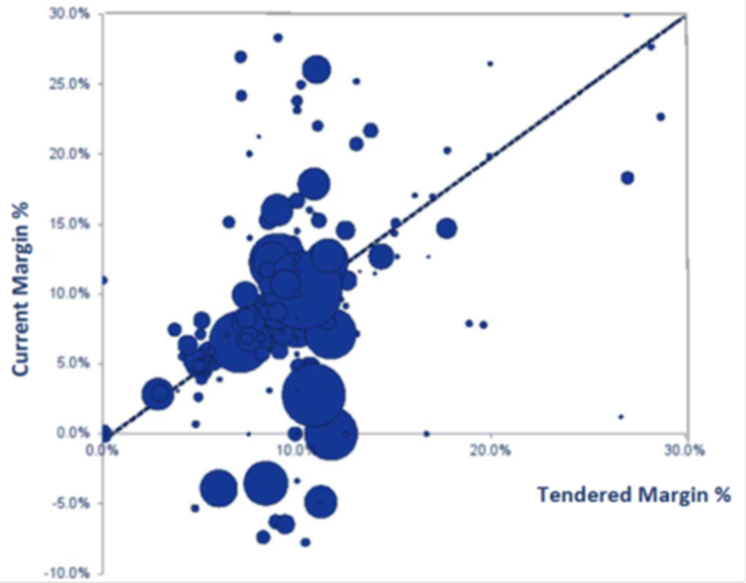
Some data – Reality!
Tendered vs Actual margin
Large project Actual performance
Project | Value | Margin | %
#1 | $2,600m | $154m | 5.9%
#2 | $5,000m | $-751m | -15.0%
#3 | $2,100m | $56m | 2.7%
#4 | $1,200m | $134m | 11.2%
#5 | $2,900m | $-400m | -13.8%
#6 | $700m | $-50m | -7.1%
#7 | $1,700m | $204m | 12.0%
#8 | $1,800m | $123m | 6.8%
TOTAL | $18,000m | $-530m | -2.9%
ISO 31000 definition of risk – “the effect of uncertainty on objectives…”
The data show uncertainty, and more downside than upside

Slide 5
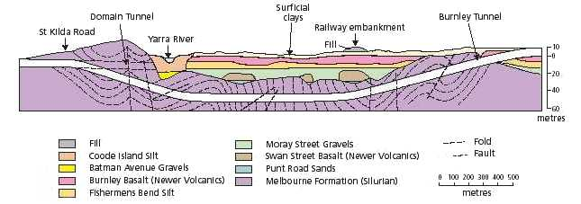
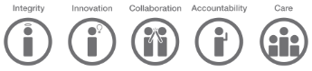

The problem
How do we bid/tender big projects?
- holds for any type of project we bid….
Mitigate risk?
Still be competitive in market place
5

Slide 6
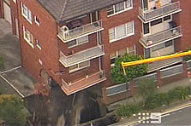
Lane Cove Tunnel 2005
Background
Collapse occurred during breakout for a ventilation tunnel from the running tunnel
A 10m by 10m, 25m deep crater formed
The failure
Possible “rock slippage”
Ground investigation did not identify dyke
Under designed rock bolts
Consequences
Building partially collapsed and 47 residents evacuated
Water main burst
Citybound road closed

Slide 7
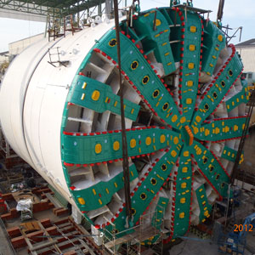
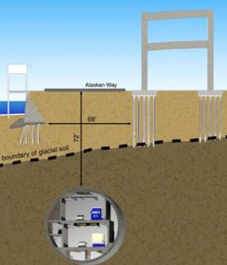
“America's Biggest Tunnel-Boring Machine Is Stuck Beneath Seattle”
Background
Replace viaduct freeway in downtown Seattle
10m/day, 3 km total
The failure
Dec 3, 2013 (300 m in) hit a 200mm steel pipe (‘investigation’ well casing)
Bearing fail – overheat, seal broken, grease mixed with sand, destroyed bearing
Consequences
Bearing worth $5M
Can replace from behind, but, need hyperbaric divers due to no air circ.
Easier from above. 37m deep repair access vault, 8m in diameter
Approx. 24 months lost
Cost $223million; court case underway

Slide 8
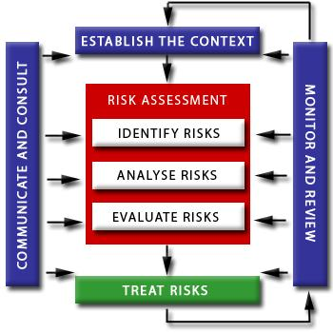
Approach – ISO 31000
Approach is to follow that mandated by ISO 31000
Context
ID
Analyse
Evaluate
Treat
Monitor, Communicate and Review
Note:
Risk = Threats (risk) & Opportunities

Slide 9
Define the Context
Context generally set, however:
Risk to us as a contractor is different to risk to client or society - $ and time
Our context will depend on type of contract proposed:
PPP – very clear, we own nearly all risk
Alliance – risk is shared
Managing Contract – Client owns risk
LCT example:
Risk to client:
Reputation, road network impacts
Risk to society:
Homeless
Risk to constructor:
Delay, insurance premium cost

Slide 10


Risk Identification
All sorts of formats, at the end of the day it is information gathering
A variation on a theme:
Series of ever more focused R&O workshops and one on one sessions
- As design is developed and methodology is refined
Informed by:
Lessons Learnt;
Past experience
Subject Matter Experts
Multi-disciplinary
Commercial, legal, political
HR/IR
Design, Construction
Stakeholder, Environment, Approvals

Slide 11
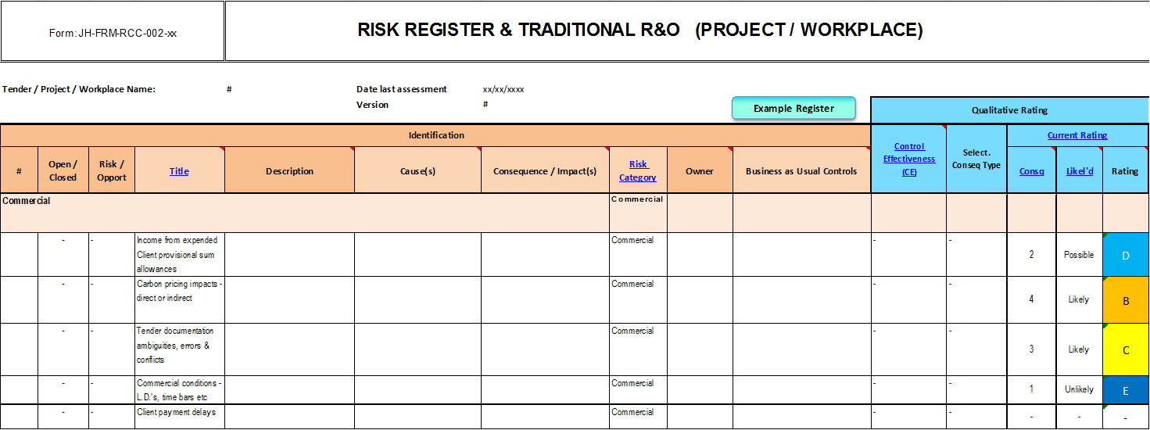
Risk Analysis
Qualitative
Risk Register & Rating Matrix

Slide 12
Risk Analysis
Quantitative
Contingency – how much money in the back pocket…
Contingency planning generally involves downside (but can include upside) risk estimates for budget and delivery times through the project lifecycle
Both the Owner/Proponent and the Constructor will generally hold a contingency
Methods:
A set amount for all projects (e.g. 10% across the board)
Internal benchmarking (i.e. against previous similar projects delivered)
External benchmarking (i.e. against other projects)
Determined via a Quantitative Risk Assessment (QRA)
Traditional (Deterministic)
Probabilistic (Monte Carlo)

Slide 13
QRA - Deterministic
Issue | Likelihood | Consequence | Allowance
Encounter unidentified services (gas, water, electricity, abandoned) | 0.6 | $ 100,000 | $ 60,000
Network provider charges increase (i.e. non contestable works) | 0.2 | $ 25,000 | $ 5,000
Unexpected interruption to services (gas, water, electricity) | 0.5 | $ 40,000 | $ 20,000
Approval delay for tree removal leads to project delay | 0.8 | $ 1,200,000 | $ 960,000
User protest/backlash leads to traffic management changes | 0.2 | $ 1,000,000 | $ 200,000
Partial collapse of excavation walls requires additional shoring | 0.3 | $ 50,000 | $ 15,000
Wet excavation materials require different methodology | 0.2 | $ 200,000 | $ 40,000
Encounter harder excavation materials – impact productivity | 0.4 | $ 500,000 | $ 200,000
Encounter additional asbestos in existing buildings | 0.1 | $ 50,000 | $ 5,000
Identify unexpected Underground Storage Tanks beneath existing building | 0.7 | $ 100,000 | $ 70,000
TOTAL |  |  | $ 1,575,000

Slide 14
QRA - Probabilistic
Literally invented by ‘rocket scientists’
Substitutes a range of values – a probability distribution function – for any factor that has uncertainty (generally applies to consequence)
The simulation recalculates the outcome thousands of times (5,000 iterations), each time randomly choosing values from each of the ranges
Each single iteration of the simulation is an analogue of a real world outcome potential
We analyse all of the simulation data (i.e. the 5,000 thousand potential outcomes) and make statistical conclusions that inform our decision making
Issue | Likelihood | Best case | Most Likely | Worst Case
Encounter unidentified services (gas, water, electricity, abandoned) | 0.6 | $ 25,000 | $ 80,000 | $ 250,000
Network provider charges increase (i.e. non contestable works) | 0.2 | $ 5,000 | $ 20,000 | $ 50,000
Unexpected interruption to services (gas, water, electricity) | 0.5 | $ 20,000 | $ 30,000 | $ 40,000
Approval delay for tree removal leads to project delay | 0.8 | $ 750,000 | $ 1,200,000 | $ 2,000,000
User protest/backlash leads to traffic management changes | 0.2 | $ 500,000 | $ 800,000 | $ 1,000,000
Partial collapse of excavation walls requires additional shoring | 0.3 | -$ 25,000 | $ 35,000 | $ 60,000
Wet excavation materials require different methodology | 0.2 | $ 50,000 | $ 100,000 | $ 200,000
Encounter harder excavation materials – impact productivity | 0.4 | $ 250,000 | $ 550,000 | $ 1,000,000
Encounter additional asbestos in existing buildings | 0.1 | $ 25,000 | $ 50,000 | $ 100,000
Identify unexpected Underground Storage Tanks beneath existing building | 0.7 | -$ 150,000 | $ 75,000 | $ 200,000

Slide 15
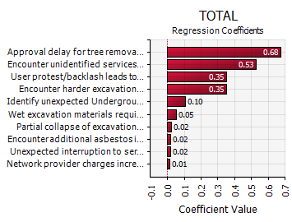
QRA - Probabilistic
Monte Carlo simulation is more resource intensive, but, produces a range of data and analysis that can be used to better understand the risk profile

Slide 16
Risk Evaluation – e.g. geotech
Comparison of the identified risks with established risk criteria
Decisions made to treat or accept the risks
Aggregate individual risks and calculate bookends.
Lower Limit
Best case production rates:
Time / programme gain for each TBM; and
Direct Job Cost savings.
Upper Limit
12 month recovery period for a TBM that is unable to progress forward due to bearing failure.
Significant mitigation required (e.g. shafts, tunnel from another location).
O/H costs & LD’s
Impact to following trades
Ground Type | m | Best Case | Worst Case | Priced
 |  | m/day | m/day | m/day
Rock type #1 | 231 | 9.5 | 3.4 | 7.3
Rock type #2 | 2,244 | 14.6 | 7.3 | 11.9
Rock interface #1 | 460 | 13.5 | 5.2 | 11.6
Rock Interface #2 | 260 | 8.4 | 3.6 | 5.1
Rock interface #3 | 210 | 5.6 | 3.3 | 3.7
Hard rock | 190 | 13.5 | 5.6 | 7.2
Based on penetration rate, ring build duration and utilisation. Sensitivity analysis to define the upper and lower bounds
Benchmarked against multiple prior projects
 | Benchmark | Tender | Difference b/c
TBM Utilisation | 42.7% | 43.3% | Less cutter head wear with slurry compared to EPB’s
Ring Build | 51min | 49 min | Double headed erector for tender
Penetration in Closed Mode | 13 mm/min | 9-11.5 mm/min | Harder & Variable Geology
Average Advance | 63 m/wk (9m/day) | 59 m/wk (8.4m/day)

Slide 17
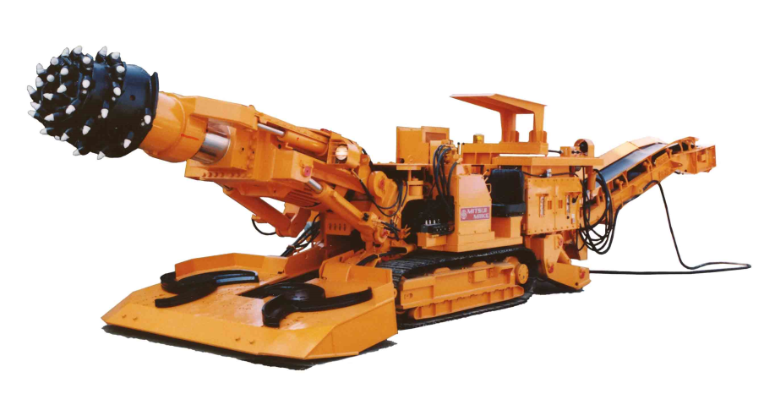
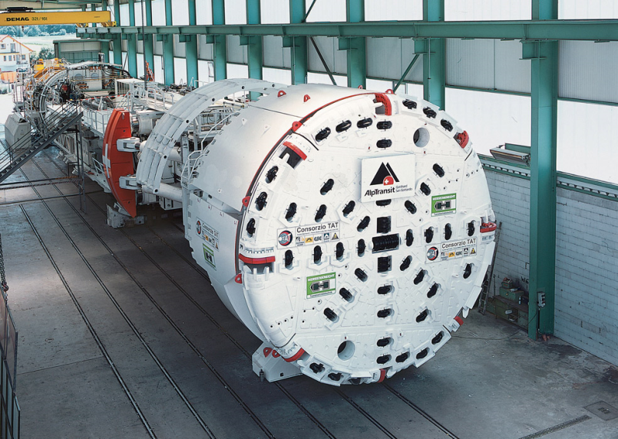
Risk Treatment
Mitigation measures – e.g. type of machine
Price into base estimate - methodology
Unacceptable?
Different methodology (e.g. machine selection)
Transfer risk
Insurable?
Manage contractually – i.e. qualify

Slide 18
Monitor and Review / Communicate
Hand over to delivery team
Revisit material:
Residual financial R&O becomes part of cost code and budgets
All other R&O becomes part of operational risk management cycle

Slide 19
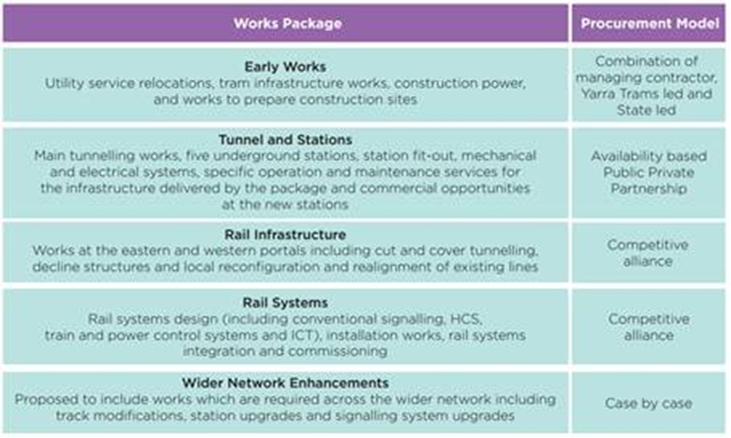
Melbourne Metro Delivery

Slide 20
Wrap and Questions

